Slide 1
Automated Document Preparation
Team Members
Goknur Caglar | Jyanne Therese Perez | Madhavi Raval | Mohamed Moosa Abdul Kader | Reon Dillon Charles | Saif Mohammed | Sze Chung Fung

Slide 2
Agenda
Problem Definition
Methodology (System Architecture & Key Components; End-to-end Workflow)
Results (Workflow in Action; Document Automation Outcomes)
Key Takeaways & Future Enhancements

Slide 3
Problem Definition
The Documentation Challenge
The Rising Need
Our Intelligent Solution
Notes:
In many organizations today, creating important documents like proposals or reports is still a manual and repetitive task. This involves copying and pasting content into templates, which can be very time-consuming and prone to errors — with up to 20% of documents containing formatting or content mistakes. This slows down workflows and affects overall productivity and quality.
Clearly, there’s a strong need for an intelligent system that automates this process
Our solution addresses this need by leveraging AI-driven workflows that can extract data from various document formats, organize content dynamically, and produce polished, professional reports automatically. Plus, it supports interactive editing and continuous improvement through user feedback.

Slide 4
System Architecture & Key Components
LLM Configuration
GPT-4.1 model with deterministic behavior (temperature=0) for consistent output
AI Agent Framework
- User Proxy Agent
- Extraction Agent
- Drafting Agent
- Editor Agent
Template-Driven Design
JSON templates reinforcing consistent formatting, tone, and structure
Human-in-the-loop
Users provide instructions and review outputs during the revision stage
Final Output
Professionally formatted DOCX and PDF ready for download

Slide 5
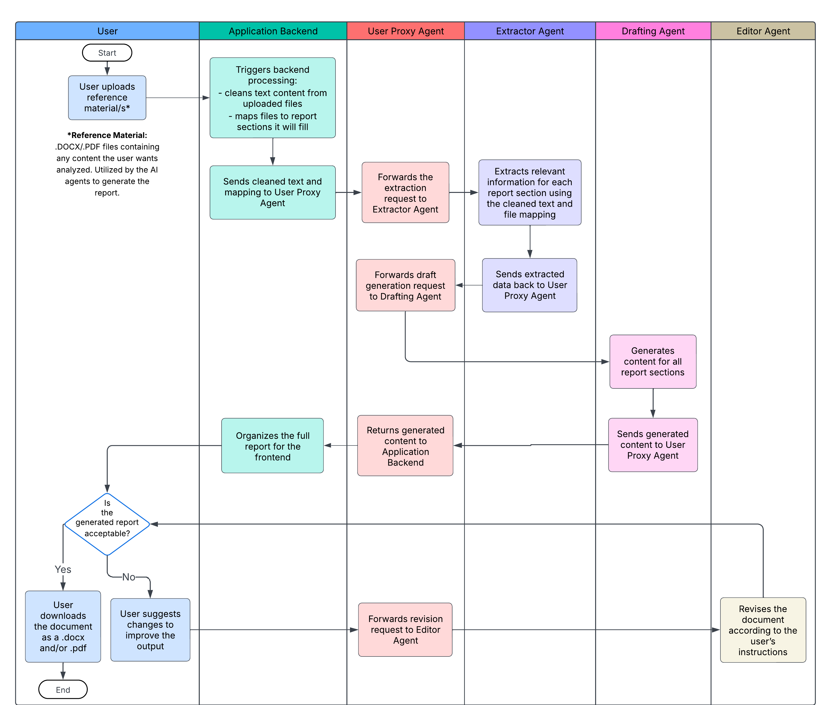
End-to-end Workflow
Notes:
Presenter: Reon
Detailed Workflow Pipeline
User uploads reference document (PDF/DOCX) and selects report template.
Preprocessing:
Extract text & layout info with PyMuPDF/pdfplumber.
Apply OCR on images using pytesseract for embedded text.
Section Identification: Parse document into hierarchical sections based on headingsand style.
Embedding Generation: Convert sections to vector embeddings for semantic search.
Agent-driven Content Retrieval: AI agents query embeddings to fetch relevantcontent.
Drafting & Composition: Draft report sections adhering to structured JSONtemplates with agent instructions.
Interactive Refinement: Users interact via chat interface to clarify, edit, or expandcontent.
Output Generation: Produce DOCX and PDF files preserving formatting andstructure.

Slide 6
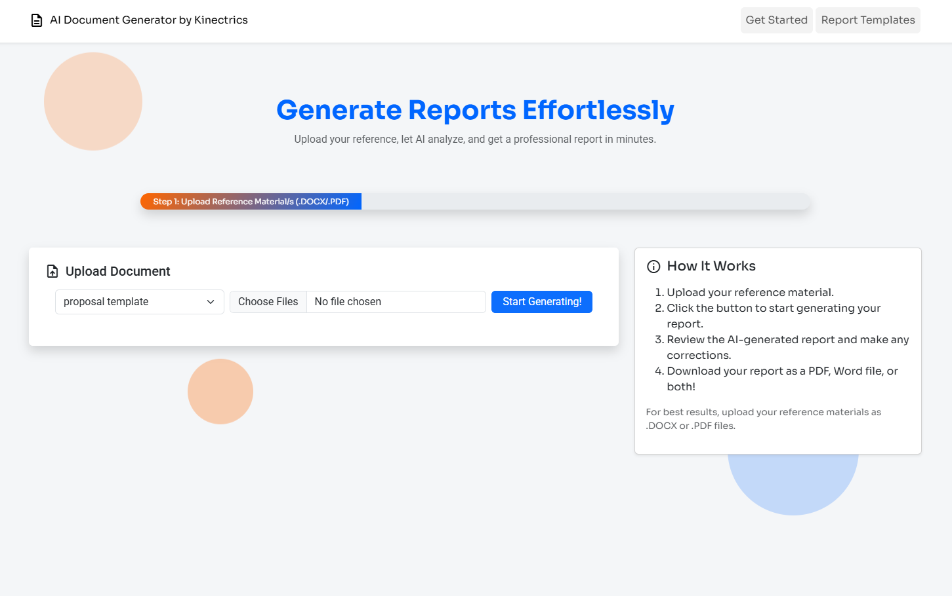
Workflow in Action (Video Demo)
Automated Doc Prep - App Demo.mp4

Slide 7
Document Automation Outcomes
Aspect | Automated System Results | Manual Process (Benchmark)
Input Format Handling | Multiple DOCX & PDF files simultaneously | Single format, manual copy-paste
Report Generation Time | 55 seconds on average | 1 to 2 hours per report
Revision Time | 23 seconds on average | 0.5 to 1 hour per report
Content Accuracy | Preserves template hierarchy, formatting, tone | Up to 20% errors in content & formatting
User Effort | Minimal (Review & Feedback) | High (manual editing and formatting)

Slide 8
Key Takeaways
The automated document generation system significantly reduces time and effort compared to manual report creation (1 – 2 hours manually vs 1 – 2 minutes automatically).
Generated reports preserve structure, formatting, and content coherence across sections.
Human-in-the-loop review ensures accuracy and allows targeted revisions, maintaining professional quality.
Future Enhancements
Incorporate user ratings and feedback to continuously improve LLM-generated content.
Enable LLM-based suggestions for phrasing, structure, and tone.
Expand capabilities with OCR input parsing
Explore migration to GPT-5
Notes:
OCR input parsing → to handle scanned or image-based documents.
Enhanced user feedback loop → using the existing rating system not just for tracking, but for fine-tuning and improving the LLM outputs.
Explore migration to GPT-5 for more advanced reasoning, reduced hallucinations, and enhanced multi-file input handling.

Slide 9
Thank you!
Notes:
Presenter: Reon
On this slide, I’ll walk you through the key objectives that guide our project.
First, our system automates the extraction and understanding of content from various document formats like DOCX and PDF, so users don’t have to manually copy and paste information.
We use modular AI agents to handle specific tasks such as extracting data, drafting report sections, and editing content, which keeps the system flexible and scalable.
To make the process interactive and user-friendly, we’ve included a chat interface where users can request refinements, allowing continuous improvement of the documents.
The system also relies on predefined templates to generate documents that maintain consistent formatting and professional appearance.
Lastly, we aim to reduce manual effort by at least 60%, while achieving 95% accuracy in extracting relevant information, which means faster and more reliable document creation for users.

